Slide 1
Computational Physics
(Lecture 15)
PHY4061

Slide 2
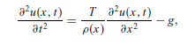
What happens if the string is not light, and/or carries a mass density ρ(x) that is not a constant?
This is an inhomogeneous equation. We can solve it with a general solution of the homogeneous equation u_{h}(x, t) (with g = 0) and a particular solution u_{p}(x, t) of the inhomogeneous equation.
g = 9.80 m/s^2 is the magnitude of the gravitational acceleration
T: the tension on the string

Slide 3

the solution of the homogeneous equation. Still separate t from x by taking u_{h}(x, t) = X(x)Θ(t); then we have
can be solved as an eigenvalue problem in ODE

Slide 4
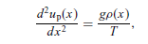
For the particular solution of the inhomogeneous equation
we can simplify the problem by considering the static case, that is, u_{p}(x, t) = u_{p}(x).
A linear equation set if we discretize the second-order derivative involved. This equation determines the shape of the string when it is in equilibrium.

Slide 5
After we obtain the general solution u_{h}(x, t) of the homogeneous equation
and a particular solution of the inhomogeneous equation, u_{p}(x) from the above static equation,
we have the general solution of the inhomogeneous equation as :
  u(x, t) = u_{h}(x, t) + u_{p}(x, t).
The initial displacement u₀(x) and initial velocity v₀(x) are still needed to determined the remaining parameters in the general solution above.

Slide 6
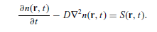
This procedure of separating variables can also be applied to higher dimensional systems.
The diffusion equation in an isotropic, three dimensional, and infinite space, with a time-dependent source and a zero initial value
The diffusion equation under a time-dependent source and a constant diffusion coefficient is given by

Slide 7
The initial value n(r, 0) = 0 will be considered first.
t = 0 in this case can be viewed as the moment of the introduction of the source.
we can view the source as an infinite number of impulsive sources, each within a time interval dτ , given by S(r, τ)δ(t − τ )dτ .
This way of treating the source is called the impulse method.

Slide 8
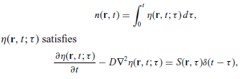
The solution n(r, t) is then the superposition of the solution in each time interval dτ , with
with η(r, 0; τ ) = 0.

Slide 9
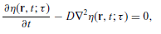
The impulse equation above is equivalent to a homogeneous equation:
with the initial condition η(r, τ; τ ) = S(r, τ).
we have transformed the Original inhomogeneous equation with a zero initial value into an integral of a function that is a solution of a homogeneous equation with a nonzero initial value!

Slide 10
We can generally write the solution of the inhomogeneous equation as the sum of a solution of the corresponding homogeneous equation and a particular solution of the inhomogeneous equation with the given initial condition satisfied.
So if we find a way to solve the corresponding homogeneous equation with a nonzero initial value, we find the solution of the general problem!

Slide 11
the separation of variables for a homogeneous diffusion equation with a nonzero initial value.
Assume that the space is an isotropic, three-dimensional, and infinite space to simplify our discussion.
Suppress the parameter τ to simplify our notation.

Slide 12
The solution of η(r, t) = η(r, t; τ ) is : η(r, t) = X(r)Θ(t),
  where X(r) is a function of r only and Θ(t) is a function of t only.
Substitute this assumed solution into the equation,
we have X(r) Θ(t) − D Θ(t)∇² X(r) = 0,
Θ’(t)/D(t) =∇² X(r)/X(r)= −k²,
where k = |k| is an introduced parameter (eigenvalue) that will be determined later.

Slide 13
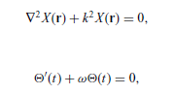
we have two separate equations:

Slide 14
The spatial equation is now a standard eigenvalue problem with k² being the eigenvalue to be determined by the specific boundary condition.
  assumed that the space is isotropic, three-dimensional, and infinite, the solution is given by plane waves with
X(r) = C exp(ik·r),
  C is a general constant.

Slide 15
Similarly, the time-dependent equation for Θ(t) is a standard initial-value problem with the solution.
  Θ(t) = B exp(−ω(t−τ )),
  ω = Dk²
  B is a coefficient to be determined by the initial condition

Slide 16
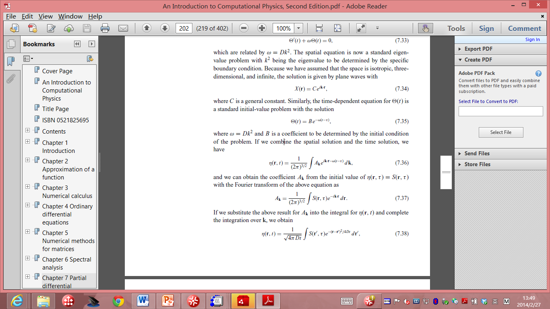
combine the spatial solution and the time solution
we can obtain the coefficient A_{k} from the initial value of η(r, τ) = S(r, τ) with the Fourier transform of the above equation as

Slide 17
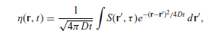
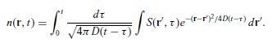
we substitute the above result for A_{k} into the integral for η(r, t) and complete the integration over k, we obtain
substituted into the integral expression of n(r, t):
One question here, how to solve it for finite boundaries?

Slide 18
This integral can be evaluated numerically if the form of S(r, t) is given.
if the space is not infinite but confined by some boundary, the solution will be in a different but similar form, because the idea of the Fourier transform is quite general in the sense of the spatial eigenstates.
In most cases, the spatial eigenstates form an orthogonal basis set which can be used for a general Fourier transform

Slide 19
Fourier analysis and orthogonal functions
an arbitrary periodic function f (t),
  with a period T ,
  can be decomposed into a summation of simple harmonic terms,
    which are periodic functions of frequencies
    that are multiples of the fundamental frequency 1/T of the function f (t).

Slide 20
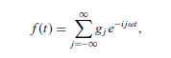
Assuming that we have a time-dependent function f (t) with a period T , that is, f (t + T ) = f (t), the Fourier theorem can be cast as a summation:
ω = 2π/T is the fundamental
angular frequency and g_{j} are the Fourier coefficients

Slide 21
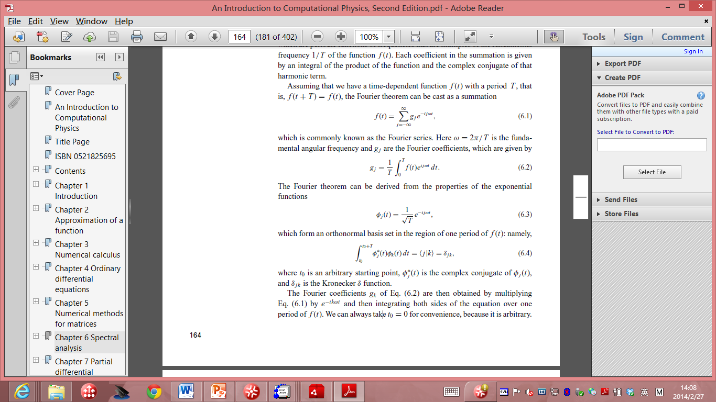
The Fourier theorem can be derived from the properties of the exponential functions:
Which form an orthonormal basis set in the region of one period of f(t):
Where t₀ is an arbitrary starting point,
Φ_{j}*(t) is the complex conjugate of Φ _{j}(t), and δ_{jk} is the Kronecker delta function.

Slide 22
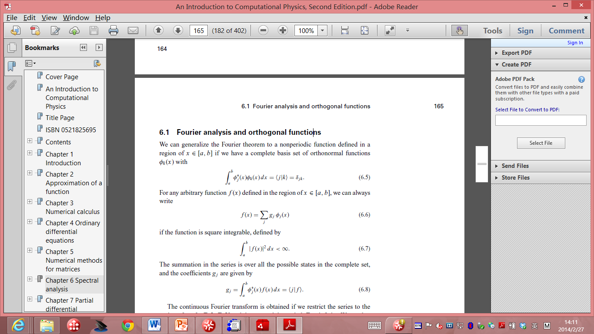
Fourier analysis and orthogonal functions
Fourier theorem to a nonperiodic function in [a, b], suppose we have a complete basis set of orthonormal functions Φ _{k} (x) with:
For any arbitrary function f(x), we have:
If the function is square integrable, defined by:
The summation in the series is over all the possible states in the complete set, and the coefficients g_{j} is given by:

Slide 23
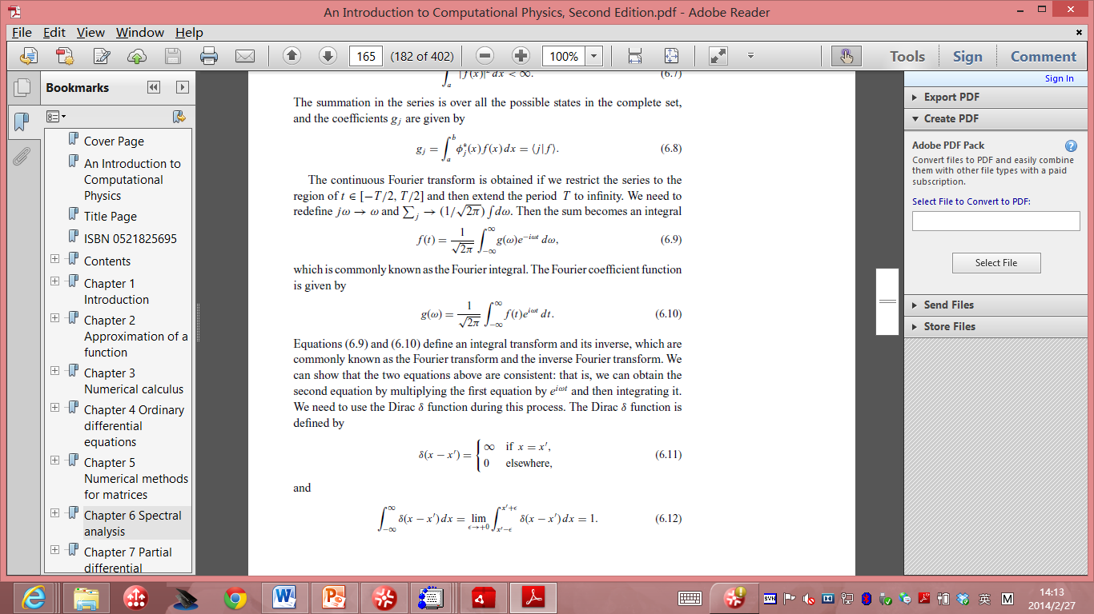
The continuous Fourier transform is obtained if we restrict the series to the region of t from –T/2 to T/2. Then we can extend the period T to infinity. Redefine :
Then the sum becomes:
This is known as the Fourier integral. The Fourier coefficient function is given by:

Slide 24
Discrete Fourier transform
The Fourier transform of a specific function:
  usually necessary in the analysis of experimental data,
  difficult to establish a clear physical picture just from the raw data taken from an experiment.
Numerical procedures for the Fourier transform:
  inevitable in physics and other scientific fields.
We have to deal with a large number of data points,
And the speed of the algorithm for the Fourier transform becomes a very important issue.

Slide 25
We need to convert the continuous variables
  into discrete ones before we develop a numerical procedure.
consider f (x) as a space-dependent physical quantity obtained from experimental measurements.
  between x = 0 and x = L, f (x) is nonzero only for x ∈ [0, L].

Slide 26
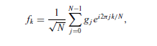
assume that the data are taken at evenly spaced points with each interval h = L/(N − 1),
  N is the total number of data points.
assume that the data repeat periodically outside the region of x ∈ [0, L], which is equivalent to imposing the periodic boundary condition on the finite system.
The corresponding wavenumber in the momentum space is then discrete too, with an interval κ = 2π/L.
The discrete Fourier transform:

Slide 27
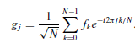
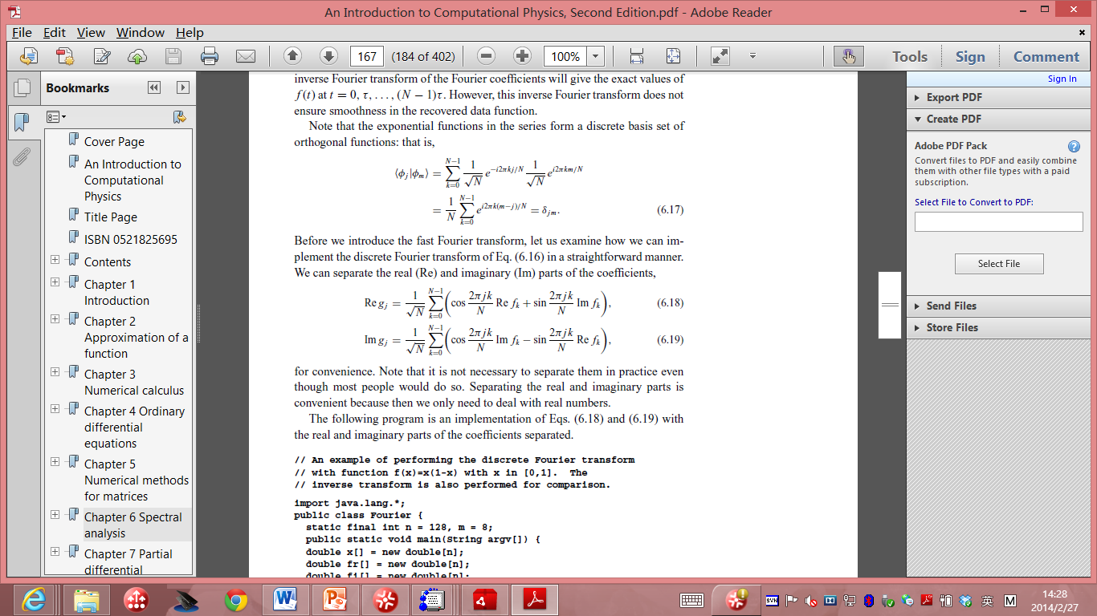
the Fourier coefficients given by
The exponential functions in the series form a discrete basis set of orthogonal functions:
We can implement the discrete Fourier transform in a straightforward manner:

Slide 28
// An example of performing the discrete Fourier transform
// with function f(x)=x(1-x) with x in [0,1]. The
// inverse transform is also performed for comparison.
import java.lang.*;
public class Fourier {
static final int n = 128, m = 8;
public static void main(String argv[]) {
double x[] = new double[n];
double fr[] = new double[n];
double fi[] = new double[n];
double gr[] = new double[n];
double gi[] = new double[n];
double h = 1.0/(n-1);
double f0 = 1/Math.sqrt(n);
// Assign the data and perform the transform
for (int i=0; i<n; ++i) {
x[i] = h*i;
fr[i] = x[i]*(1-x[i]);
fi[i] = 0;
}
dft(fr, fi, gr, gi);
// Perform the inverse Fourier transform
for (int i=0; i<n; ++i) {
gr[i] = f0*gr[i];
gi[i] = -f0*gi[i];
fr[i] = fi[i] = 0;
}
dft(gr, gi, fr, fi);
for (int i=0; i<n; ++i) {
fr[i] = f0*fr[i];
fi[i] = -f0*fi[i];
}
// Output the result in every m data steps
for (int i=0; i<n; i+=m)
System.out.println(x[i] + " " + fr[i] + " " fi[i]);
}

Slide 29
// Method to perform the discrete Foruier transform. Here
// fr[] and fi[] are the real and imaginary parts of the
// data with the correponding outputs gr[] and gi[].
public static void dft(double fr[], double fi[],
double gr[], double gi[]) {
int n = fr.length;
double x = 2*Math.PI/n;
for (int i=0; i<n; ++i) {
for (int j=0; j<n; ++j) {
double q = x*j*i;
gr[i] += fr[j]*Math.cos(q)+fi[j]*Math.sin(q);
gi[i] += fi[j]*Math.cos(q)-fr[j]*Math.sin(q);
}
}
}
}

Slide 30
computing time that is proportional to N²
We can use f (x) = x(1 − x) as the data function to test the method in the region of x ∈ [0, 1].

Slide 31
